Slide 1
Infinity Digital Banking
Make your life easier

Slide 2
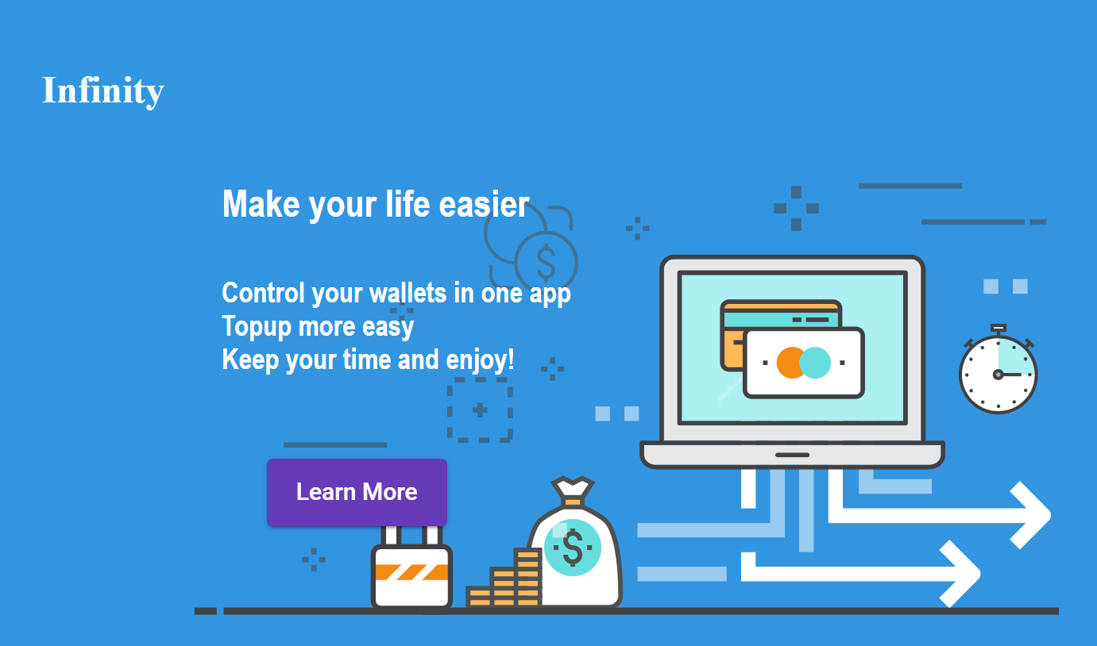

Slide 3
Why ?
Management your accont and wallet more easy
One customer can create more than one account and wallet
Complete report transaction

Slide 4
How ?
Register
Login
Create Account
Transaction
Register Account to Wallet
Create Wallet

Slide 5
Transaction Features
Top up
Transfer
Withdraw

Slide 6
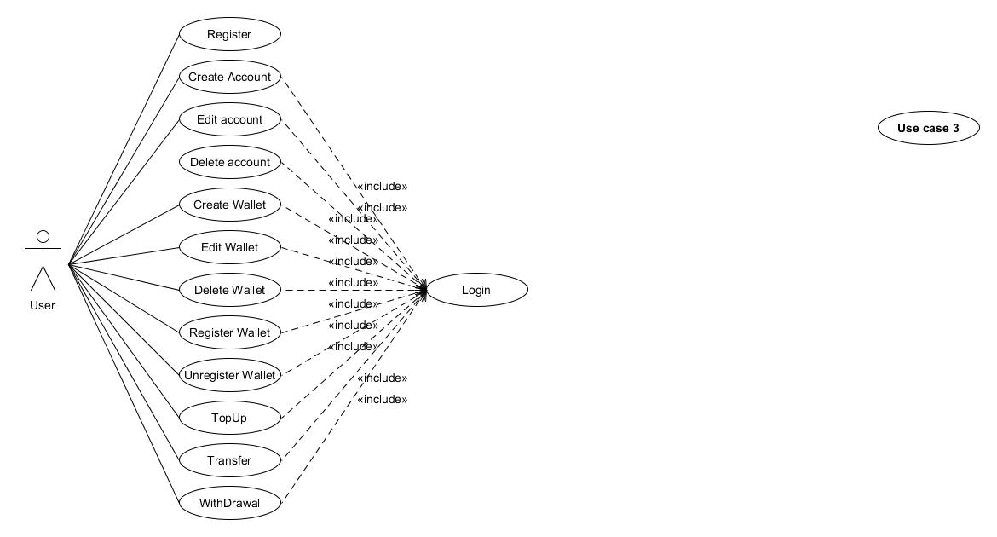
Use Case

Slide 7
Check This Out

